Slide 1
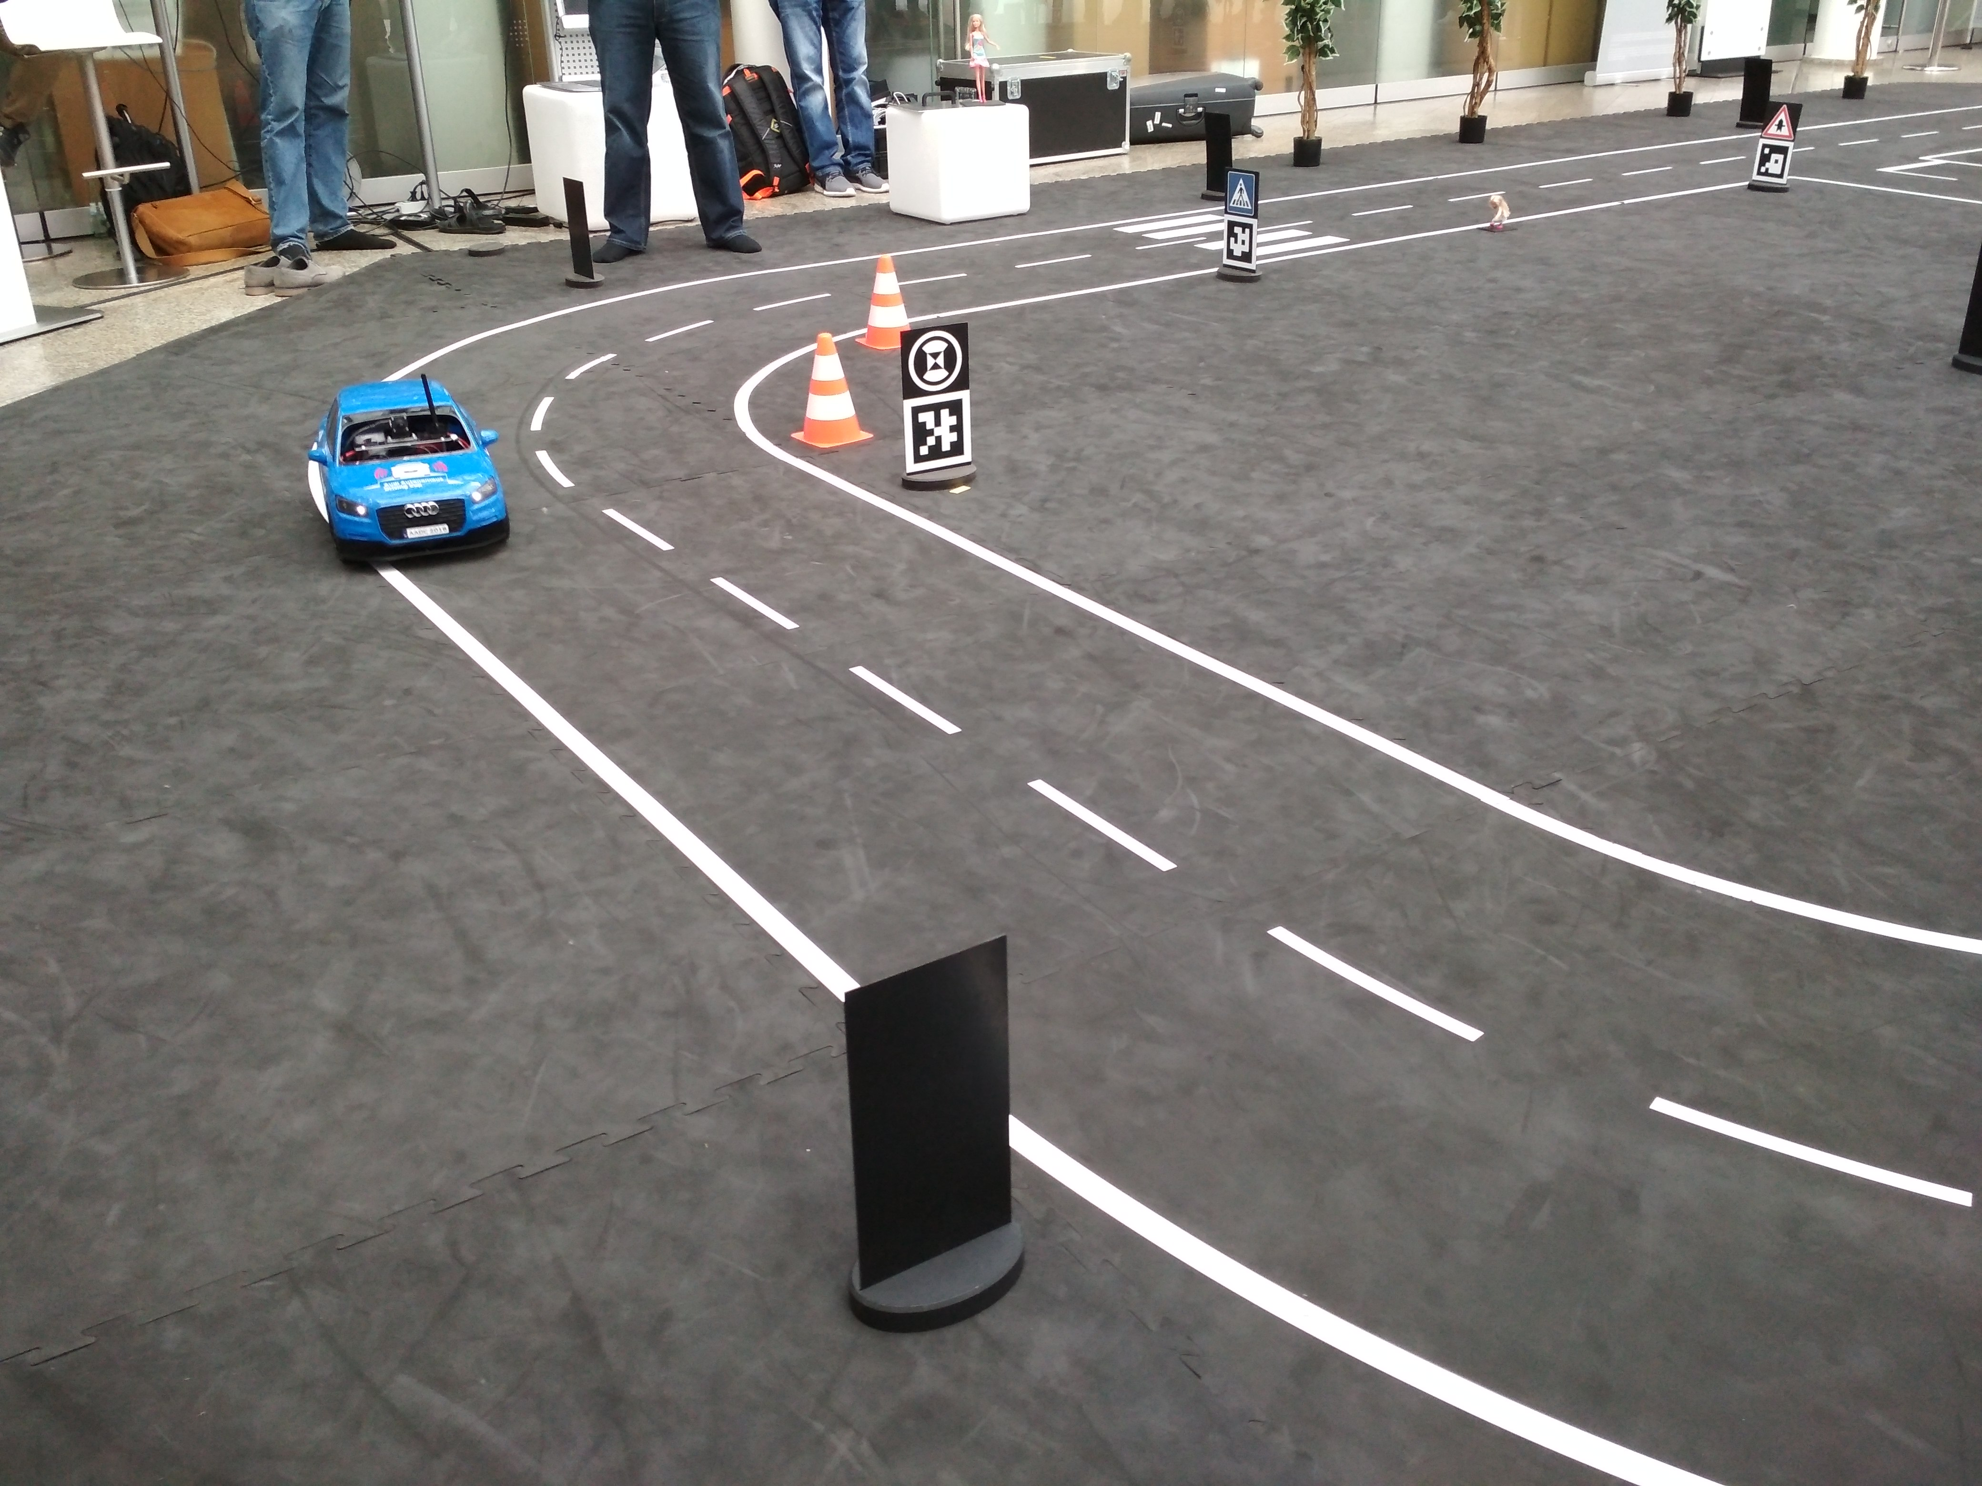
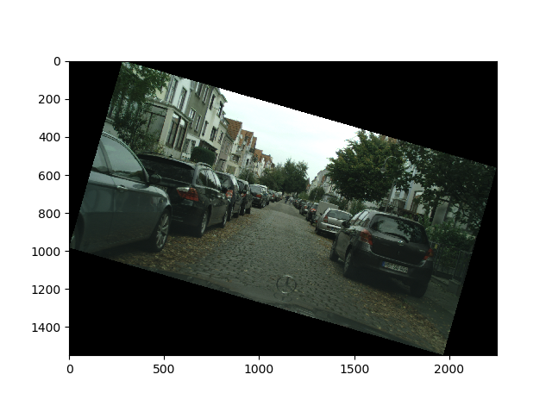
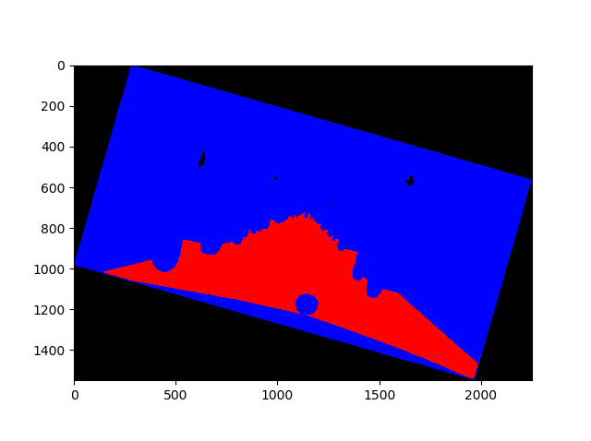
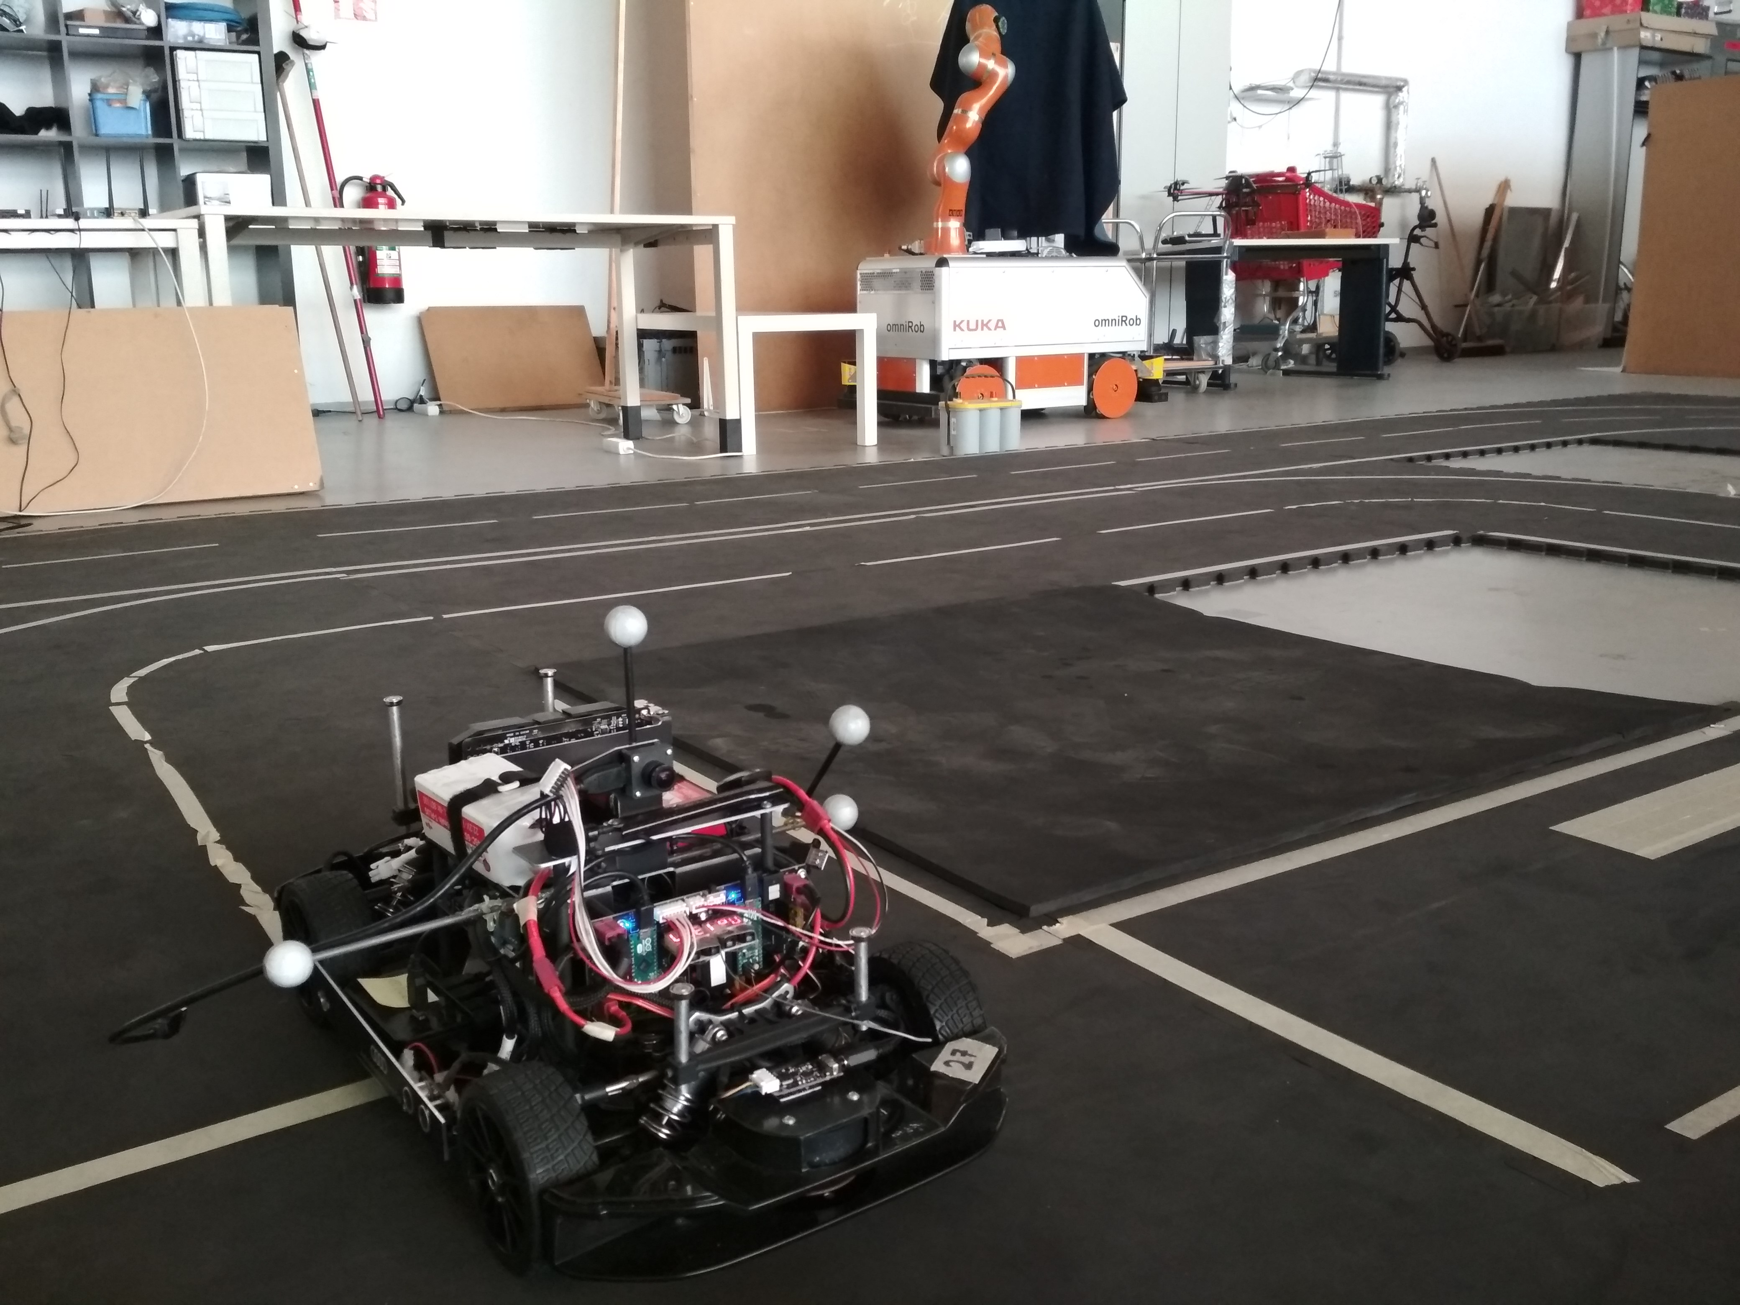
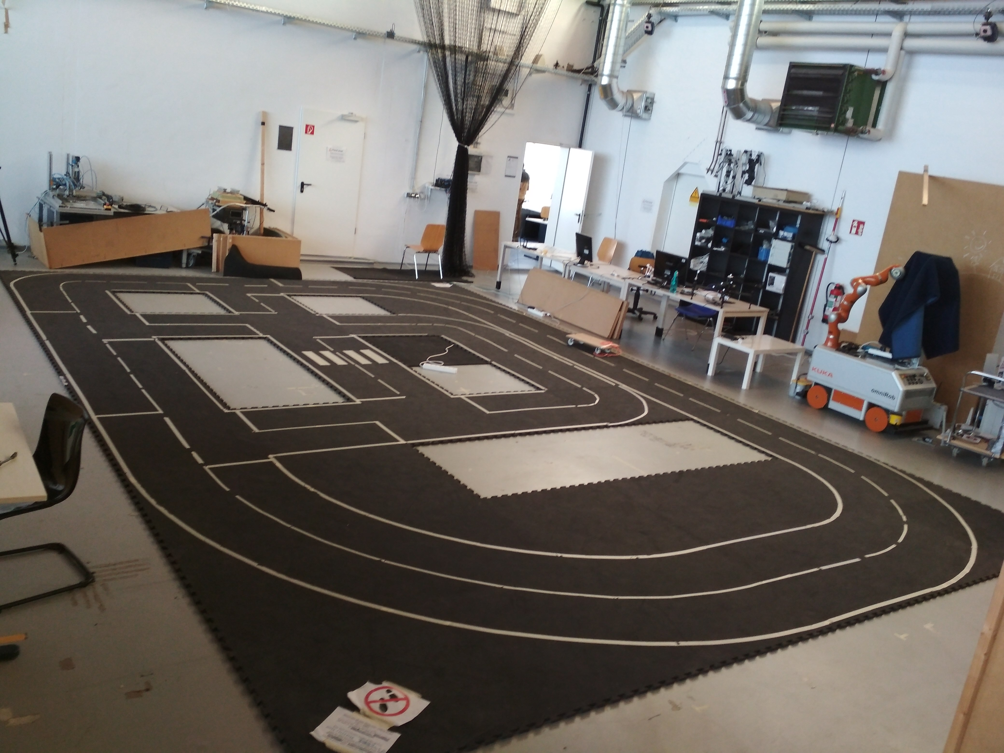
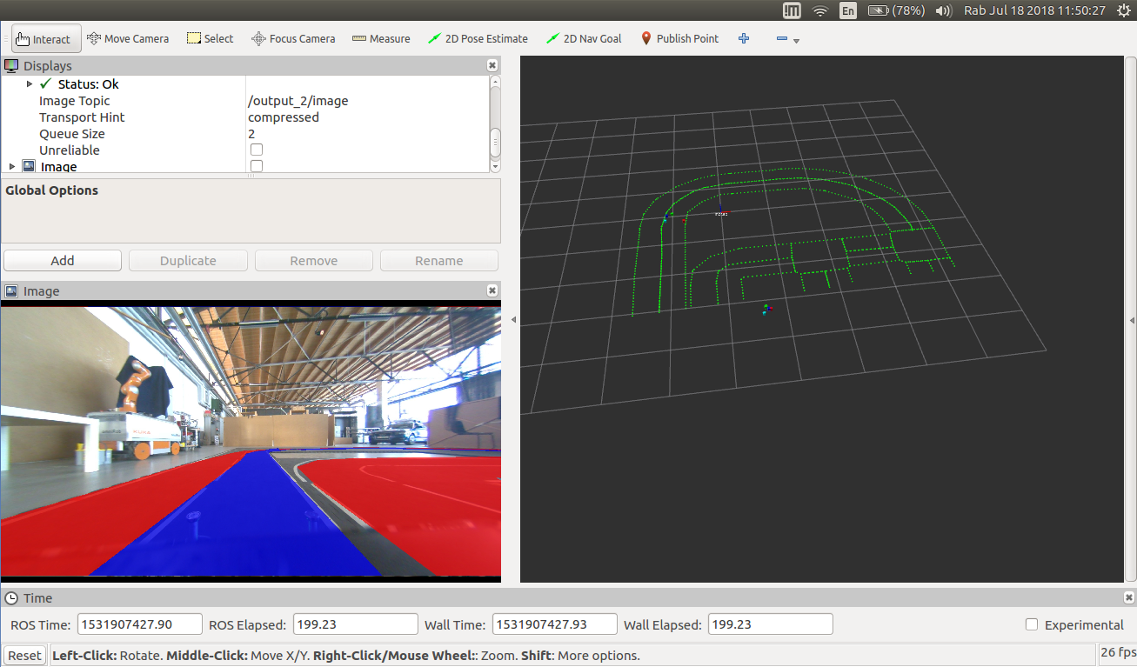
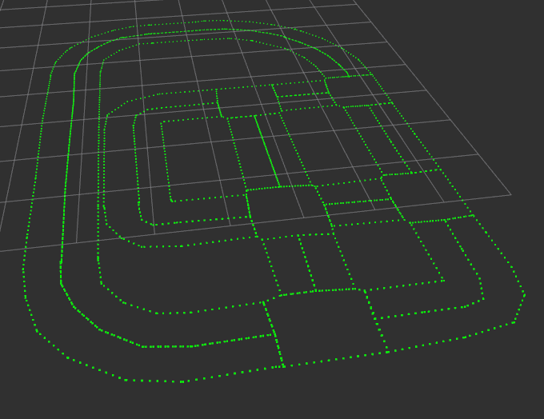
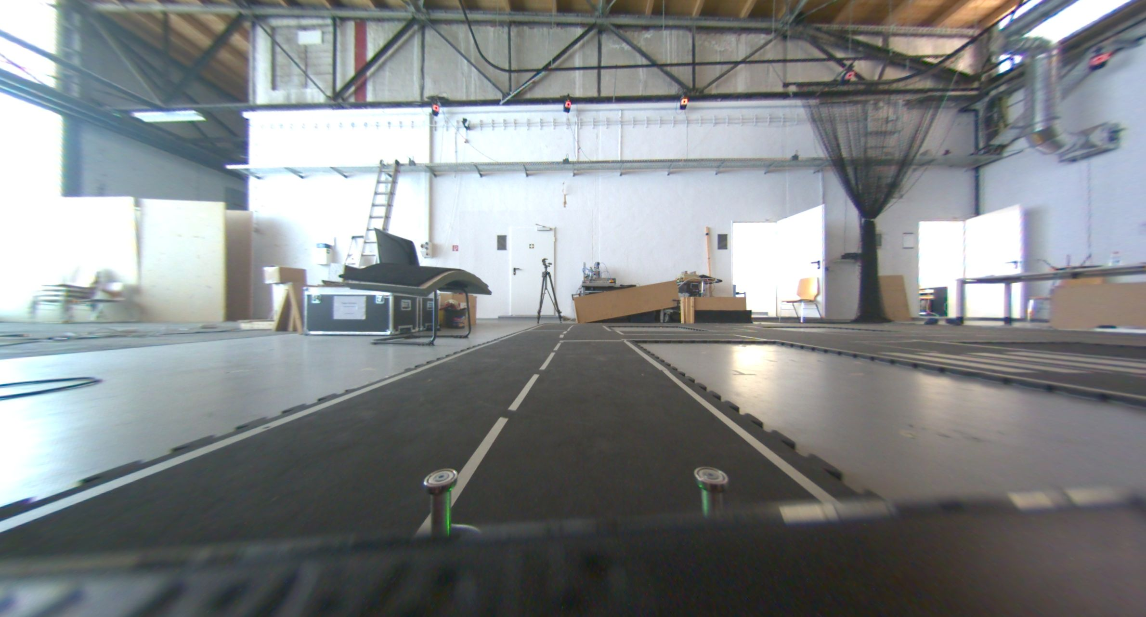
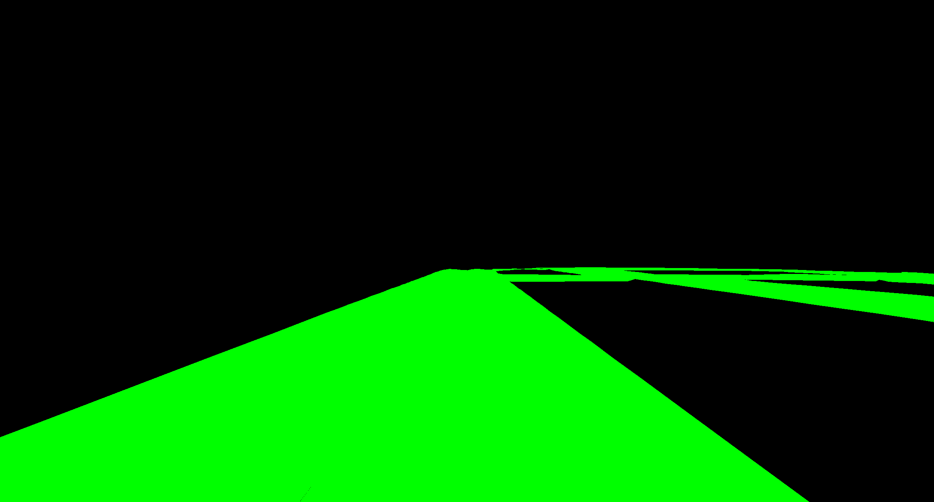
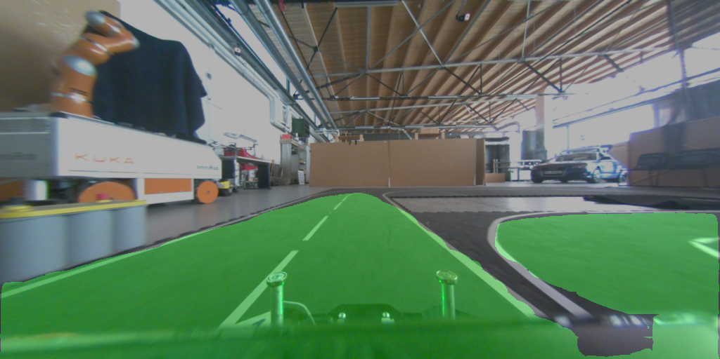
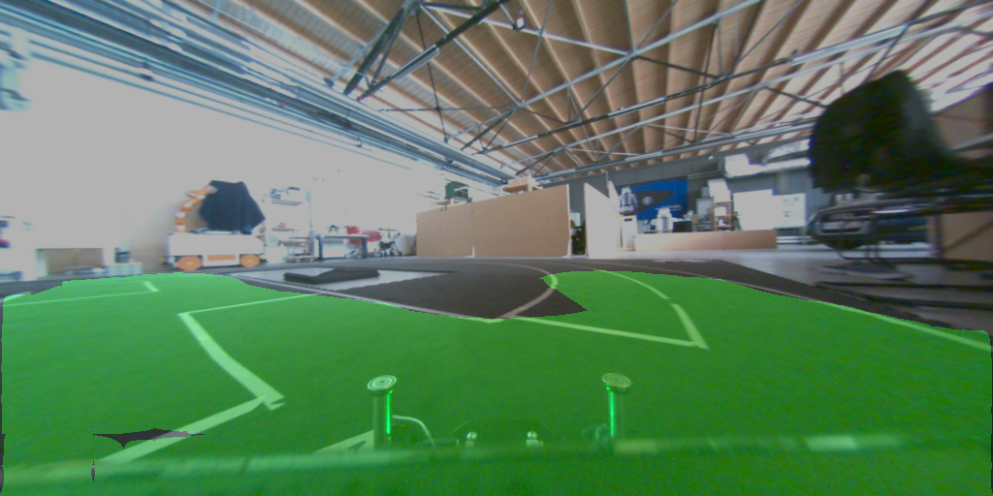
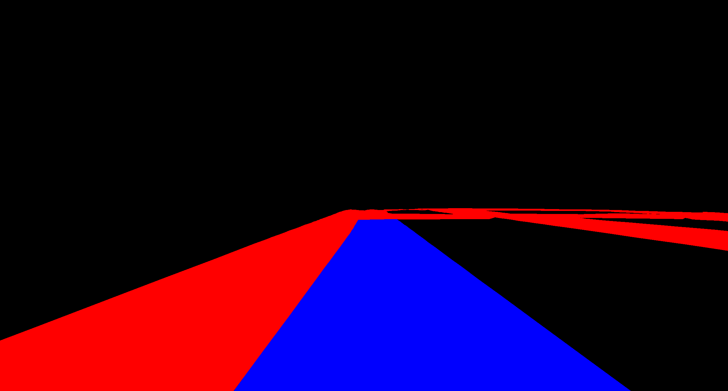
Semantic Road Segmentation for
1/8 Scale Car
Eirik Fagerhaug, Novian Habibie
Project goals
Detect the road in input images using semantic segmentation.
Scaled-down Deep Neural Network to fit in limited resources (race car model).
Create annotated ground truth of simulation track semi-automatically.
FCN for Semantic Segmentation
Main model : Scaled-down FCN32.
Also trained high-spec DNN : DeepLab.
Pre-experiment training using Cityscape dataset. Simplified segment classes : road and non-road.
Use data augmentation : rotate, scale, resize brightness, contrast, gamma, saturation.
Environment Representation
Remote-controlled 1/8 car model (manual driving).
Right side driving.
Input as sequence of images from Basler camera.
Hand-assembled car track, indoor.
Using motion capture system as position tracking.
Semi-Automatic Dataset Generation
Car track map as set of polygons, captured manually using marker wand. Interpolated to get smoother polygons. Refined by hand
Record (undistorted) raw images with calibrated camera and pos of car from MoCap system as ROS bagfiles
Create label images by backproject seen polygons in camera field-of-view w.r.t pose of car to 2D images.
Provide two types of label images:
1. 1-class : only road and non-road.
2. 3-class : current lane, intersection, other lanes.
Result
8698 set of data (raw image, 1-class, 3-class) from 6240.890 seconds of ROS bagfiles.
Live ground truth visualization (label image & seen polygons).
Fast road segmentation using scaled-down FCN32 (~0.015 second/image) on GPU (NVIDIA 1060).
Notes:
1

